Slide 1


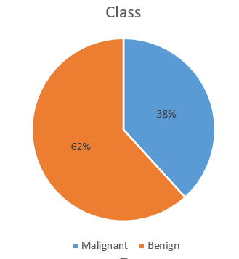
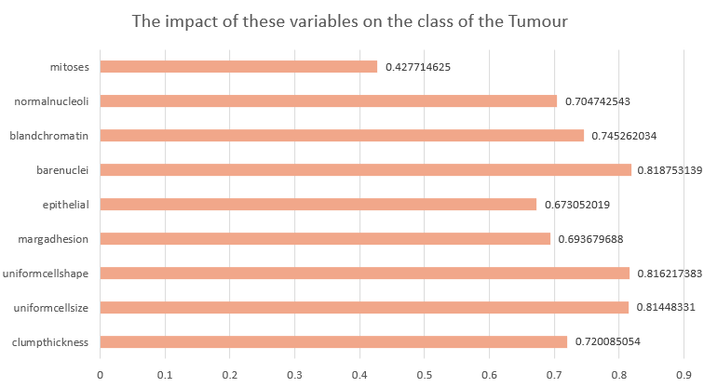
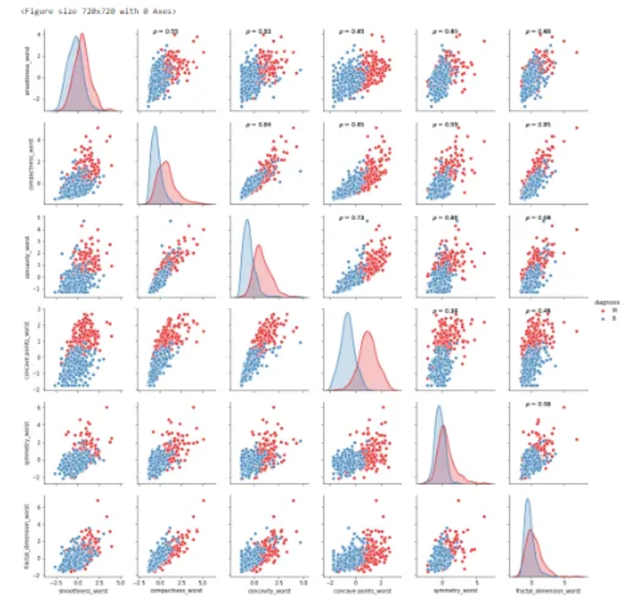
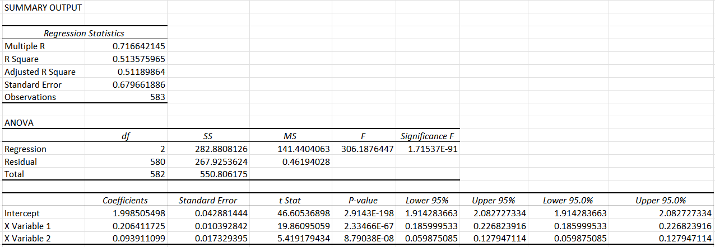
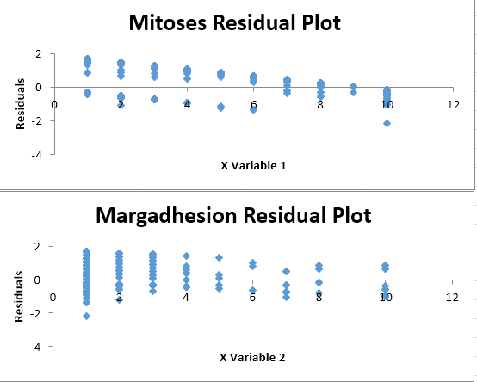
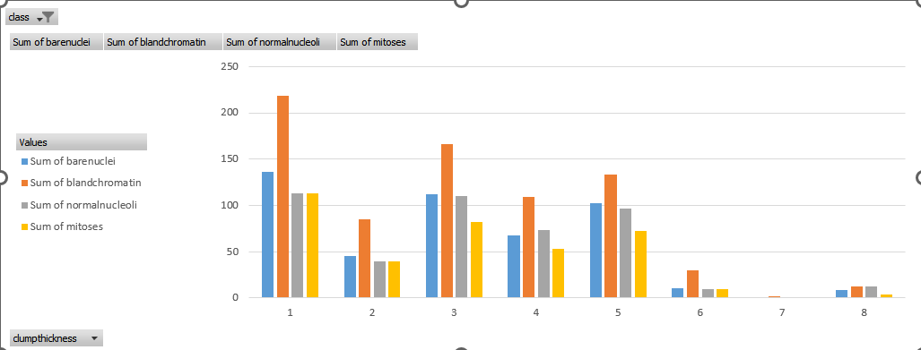
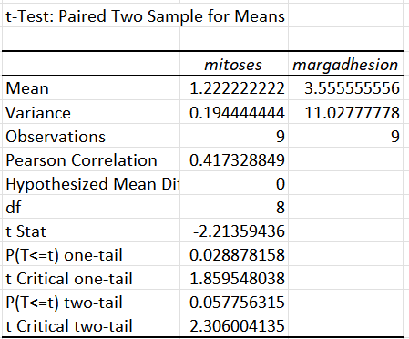
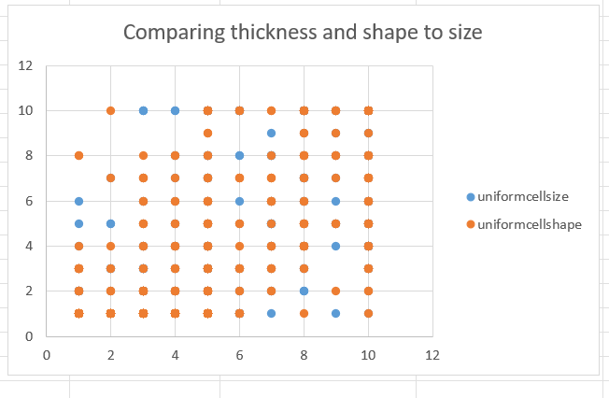
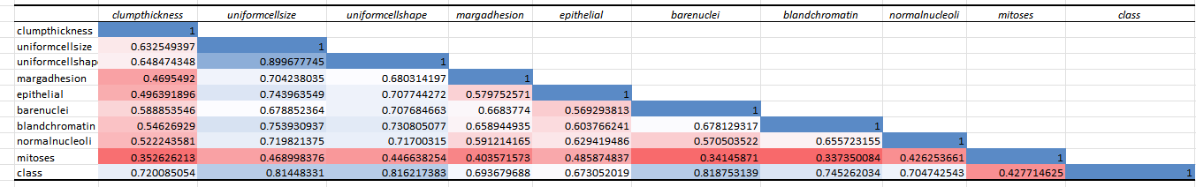
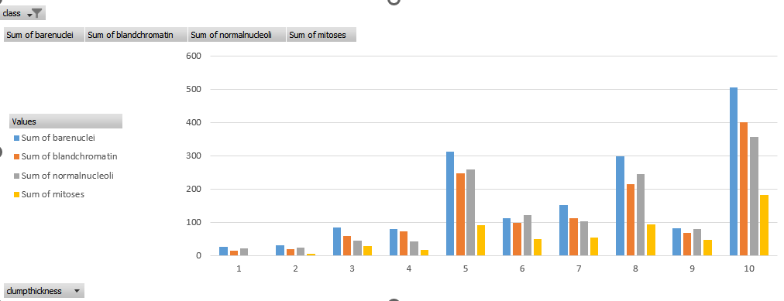
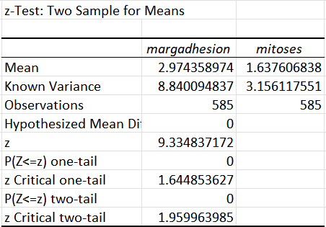
Tumor Data Anmool Shah
Introduction
Methods
Results
Conclusions
Figure 1
Figure 7
Linear regression model to predict the general outcome
The regression model is used for predictions in the test data
Figure 5
yhat=1.99850549838208+(0.206411724549558*x2) intercept+(0.0939110993436335
Figure 5.1
Figure 7 is a bar chart that represents what variable impacts the class of the tumour the most and least. Bare nuclei has a big impact on tumour class while mitosis has a lesser impact.
Figure 1:
The pie chart in Figure 1 represents the ratio of malignant to benign tumour classes
Figure 3
Figure 5.2
Figure 2.1
Figure 4
Figure 8.1
Figure 6
Figure 2.1
Figure 8.2
The scatterplot in Figure 4 compares the uniform cell size to the uniform cell shape
The bar charts in Figure 2.1 and Figure 2.2 represents the sum of bare nuclei, sum of blank chromatin, sum of normal nucleii and sum of mitosis in benign (Figure 2.1) or malignant (Figure 2.2)
The correlation matrix heatmap in Figure 6 shows the impact of each variable to each other.

